Slide 1
Big Mountain Resort
Maximize Revenue, Maximize Profits

Slide 2
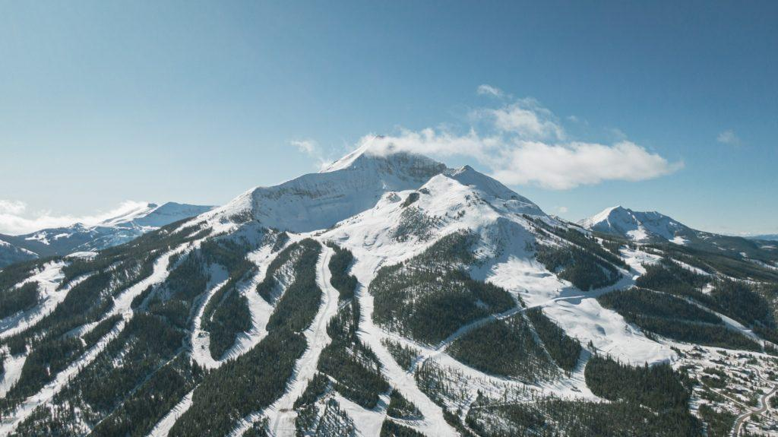
Context:
Big Mountain Resort (BMR) hosts about 350,000 skiers and riders of all levels and abilities annually. BMR has based their price solely on the market average. However, this approach limits investment strategy. BMR wants guidance on how to select a better value for their ticket price.

Slide 3
What opportunities exist for Big Mountain Resort to increase their ticket pricing and thus their annual revenue for the upcoming ski season?

Slide 4
Recommendations and Key Findings
Big Mountain Resort is UNDERCHARGING!
- Big Mountain currently charges $81.00 dollars for an Adult Weekend ticket to their resort.
- Our trained model returned a price of $95.87 with a MAE $10.39.

Slide 5
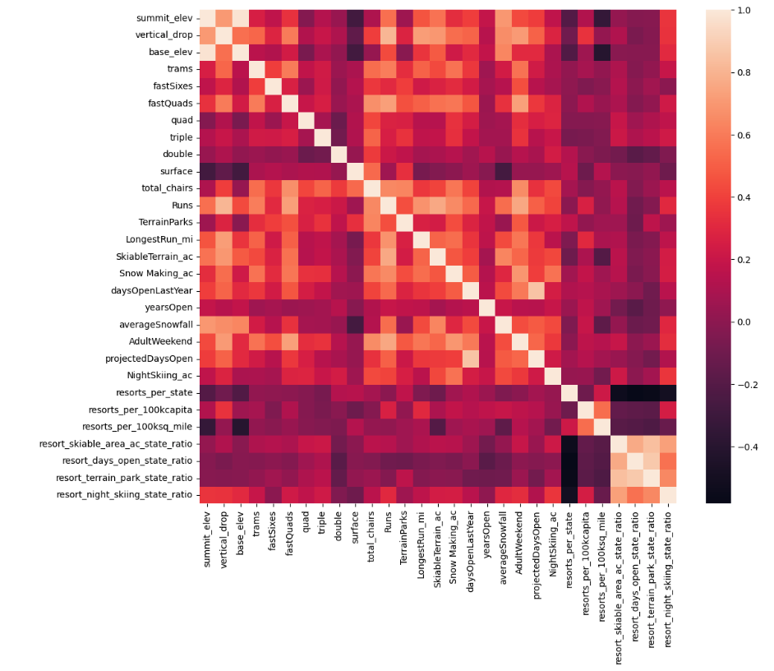
Exploratory Analysis Reveals…
One can see a relationship between Adult Weekend Ticket Price and:
FastQuads,
Vertical Drop,
Runs,
Total Chairs,
Snowmaking_ac,
Resort_night_skiing_ratio

Slide 6
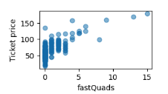
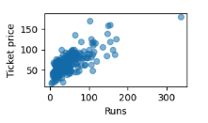
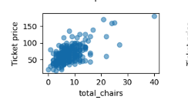
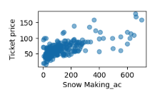
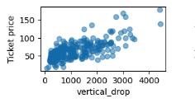
Scatterplots Confirm Positive Correlation with Adult Ticket Price

Slide 7
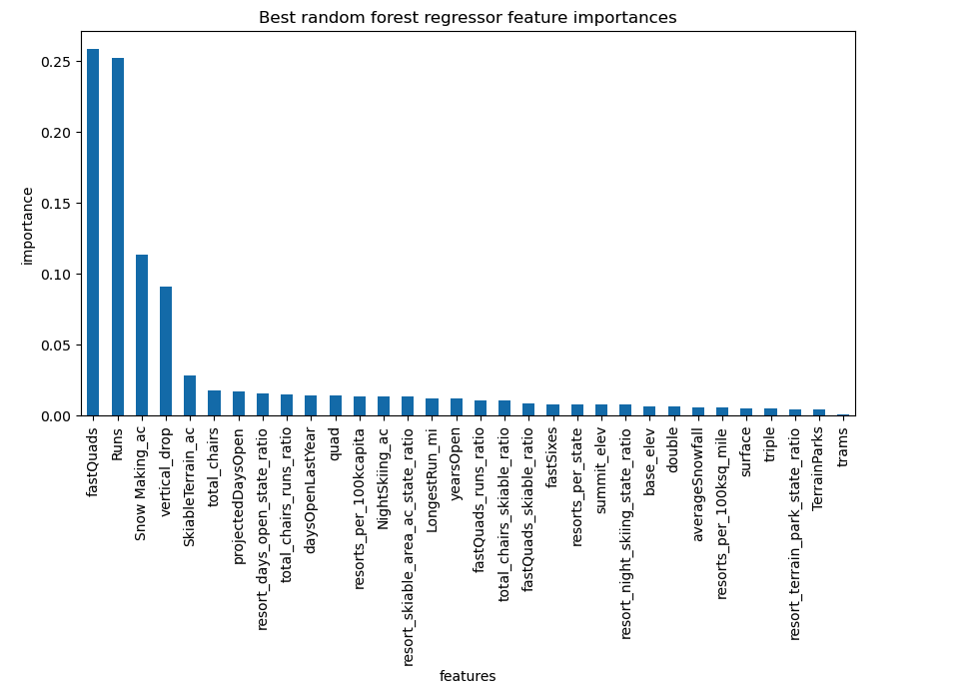
RANDOM FOREST REGRESSOR - Feature Importance

Slide 8
In conclusion:
BIG MOUNTAIN RESORT MUST INCREASE PRICES!
Ticket Prices should be $95.87!
ADDITIONALLY, our model reveals…
BMR can raise prices by an additional $1.99 if they:
add a run, increase their vertical drop, and installed an additional chair lift
This will increase revenue by $3.5M and thus offset the additional annual operating costs of $1.5M.
If recommendations are followed, gross revenue will be $1.9M!

